Slide 1
Universities of Sweden

Slide 2
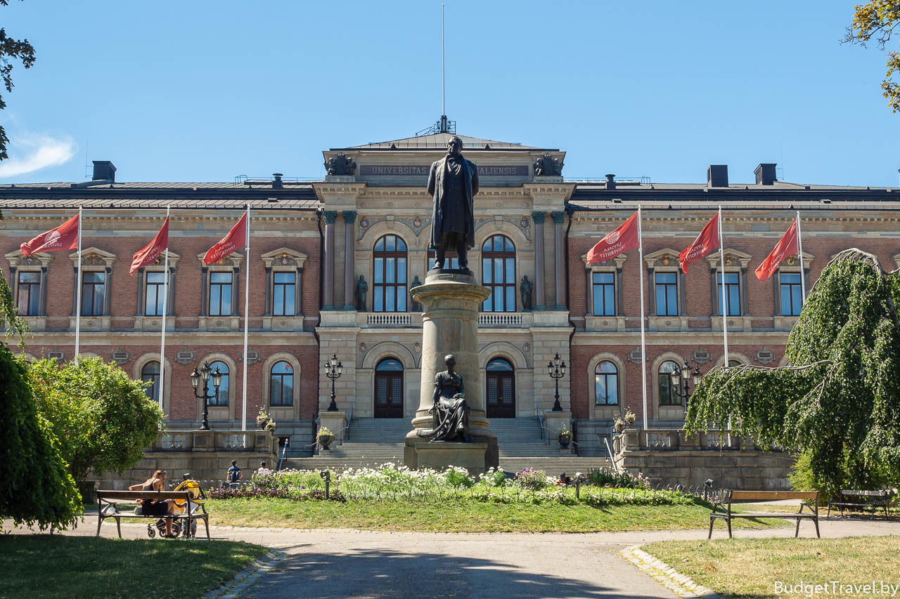
Uppsala University is the oldest university in Sweden and the whole of Scandinavia, founded in 1477, located in the Swedish city of Uppsala. It has 9 faculties (6 humanities and social sciences: theology, law, arts, languages, social sciences, pedagogical sciences; as well as medicine, pharmacy, science and technology).
The university is associated with the names of scientists such as Karl Linney, Anders Celsius, Johan Vallerius, Anders Angstrom, Adam Afzelius, Per Afcelius, Svante Arrhenius.

Slide 3
King Gustav Adolf donated all his family wealth to the university. In 1894 there were 122 teachers, 1570 students: at the Faculty of Philosophy - 498, at the Law - 479, at the Theological - 362, at the Medical - 231. In 1956, the Faculty of Philosophy was divided into the Faculty of Arts and the Faculty of Science and Technology. In 1964, the Department of Social Sciences was separated from the Faculty of Arts. In 1968, the Institute of Pharmacy, which moved to Uppsala from Stockholm, became part of the university as a faculty. In 1967, a branch of the University of Orebro was opened, now an independent university. The university library has rare manuscripts, among which are the notes of Gustav Badin, a black boy slave who became a prominent court and state official at the court of the three Swedish kings in the late XVIII - early XIX centuries.
Library

Slide 4
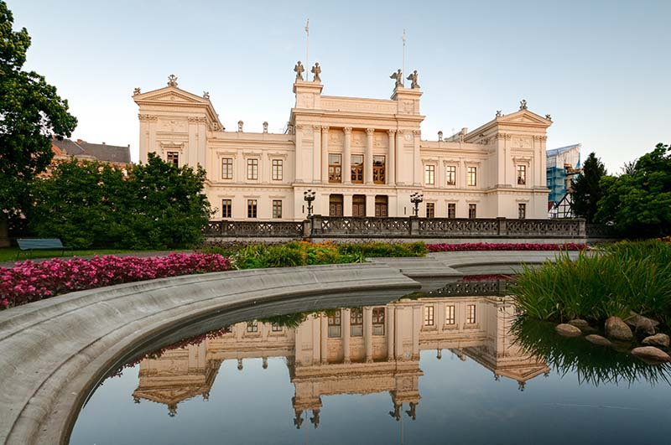
Lund University is a university in the city of Lund in southern Sweden, founded in 1666, the second oldest university within the current borders of Sweden.
There are seven faculties at Lund University (with additional campuses in the cities of Malmo and Helsingborg), more than 34 thousand students study in 50 different programs (specialties) and 800 separate courses. Lund University is part of Universitas 21, a worldwide network of universities with extensive research.
After the conclusion of peace in Roskilde in 1658, the province of Skåne passed into the possession of the Swedish crown, which quickly founded Lund University in 1666 as a means of "Swedishification." It became the fifth university founded by the Swedish royal authority, after Uppsala University in 1477, Academia Gustaviana in 1632 (now in Estonia), Abo Academy in 1640 (now in Finland) and the University of Greifswald in 1648 (now in Germany).

Slide 5
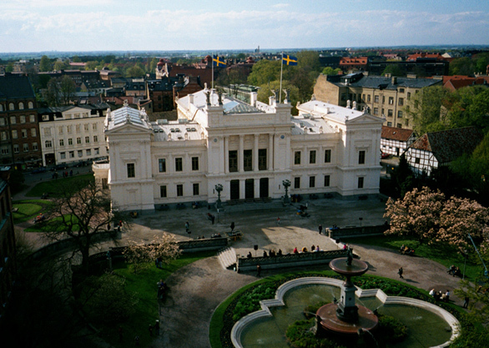
The university was named Academia Carolina after King of Sweden Carl X Gustav. This name was formally used until the end of the 19th century, when the name “Lund University” became widespread. When the university was founded, four faculties were opened in it: legal, theological, medical and philosophical. They were the "cornerstones" and this system has been in operation for 200 years. At the end of the XVII century, the number of students reached 100.
The Skone war in 1676 led to the closure of the university, which lasted until 1682. The university was reopened largely due to regional patriots, but until the 19th century the university did not have a high status. There were few lecture halls, and classes were held in the Lund Cathedral and the chapel adjacent to it. The salaries of the professors were low. In 1716, King Charles XII of Sweden made Lund his permanent residence, not wanting to return to Stockholm. He remained in the city for two years, in between his Norwegian campaigns. The city and university enjoyed a surge of temporary attention.

Slide 6
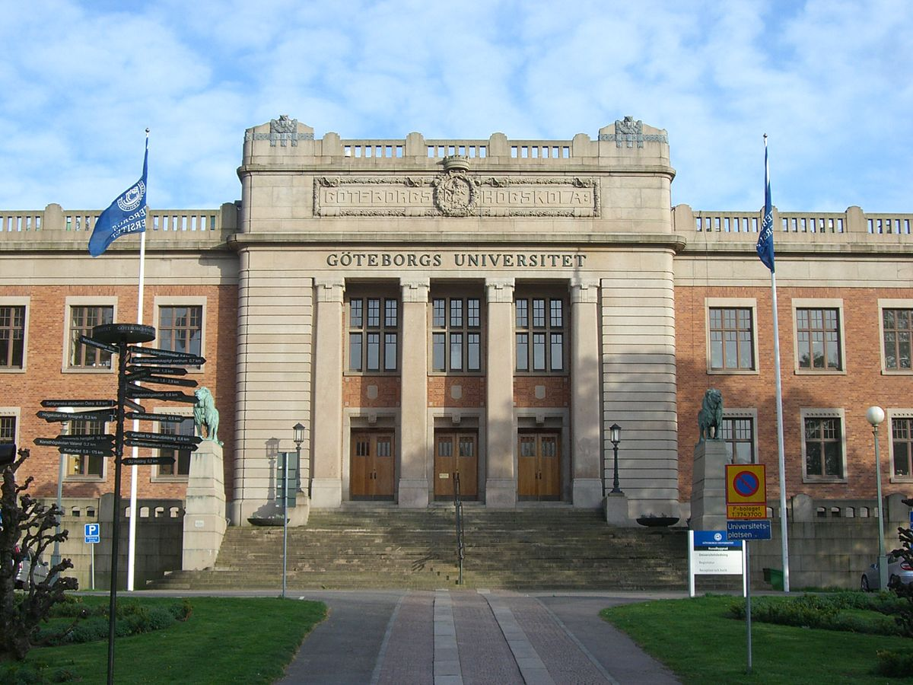
University of Gothenburg - University of Gothenburg (Sweden). Gothenburg University, with about 37,000 students, is one of the largest in Scandinavia.
The university was founded in 1891 as the Göteborgs högskola (Gothenburg Graduate School) and eventually combined all the higher education institutions in the city. He became a full-fledged university in 1954 after merging with the Gothenburg School of Medicine. The main building and most of the faculties are located in the central part of Gothenburg.

Slide 7
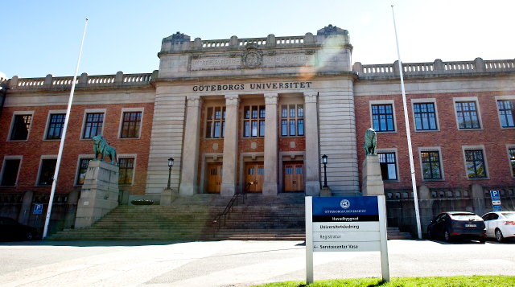
Faculties
Academy of Medicine Sahlgrenska
Faculty of Art
School of Fine Arts Valand
Faculty of Social Sciences
School of Business, Economics and Law
Faculty of Education
Faculty of Science
University of Gothenburg IT

